Slide 1

servers
Notes:
BRIAN:
Quick intro to serverless
Maturity model
Wardley map, discussion on utilities
Benefits / ideas about how this changes everything
Adoption ideas
Focus on high value changes
Challenges to implement
Experiences at GameStop

Slide 2



Jack Warner
jack.warner@parivedasolutions.com
/jackwarner
Phillip Manwaring
phillip.manwaring@parivedasolutions.com
/manwaring
Notes:
BRIAN

Slide 3
Your business doesn’t have technology problems
Notes:
PHILLIP

Slide 4


Slide 5
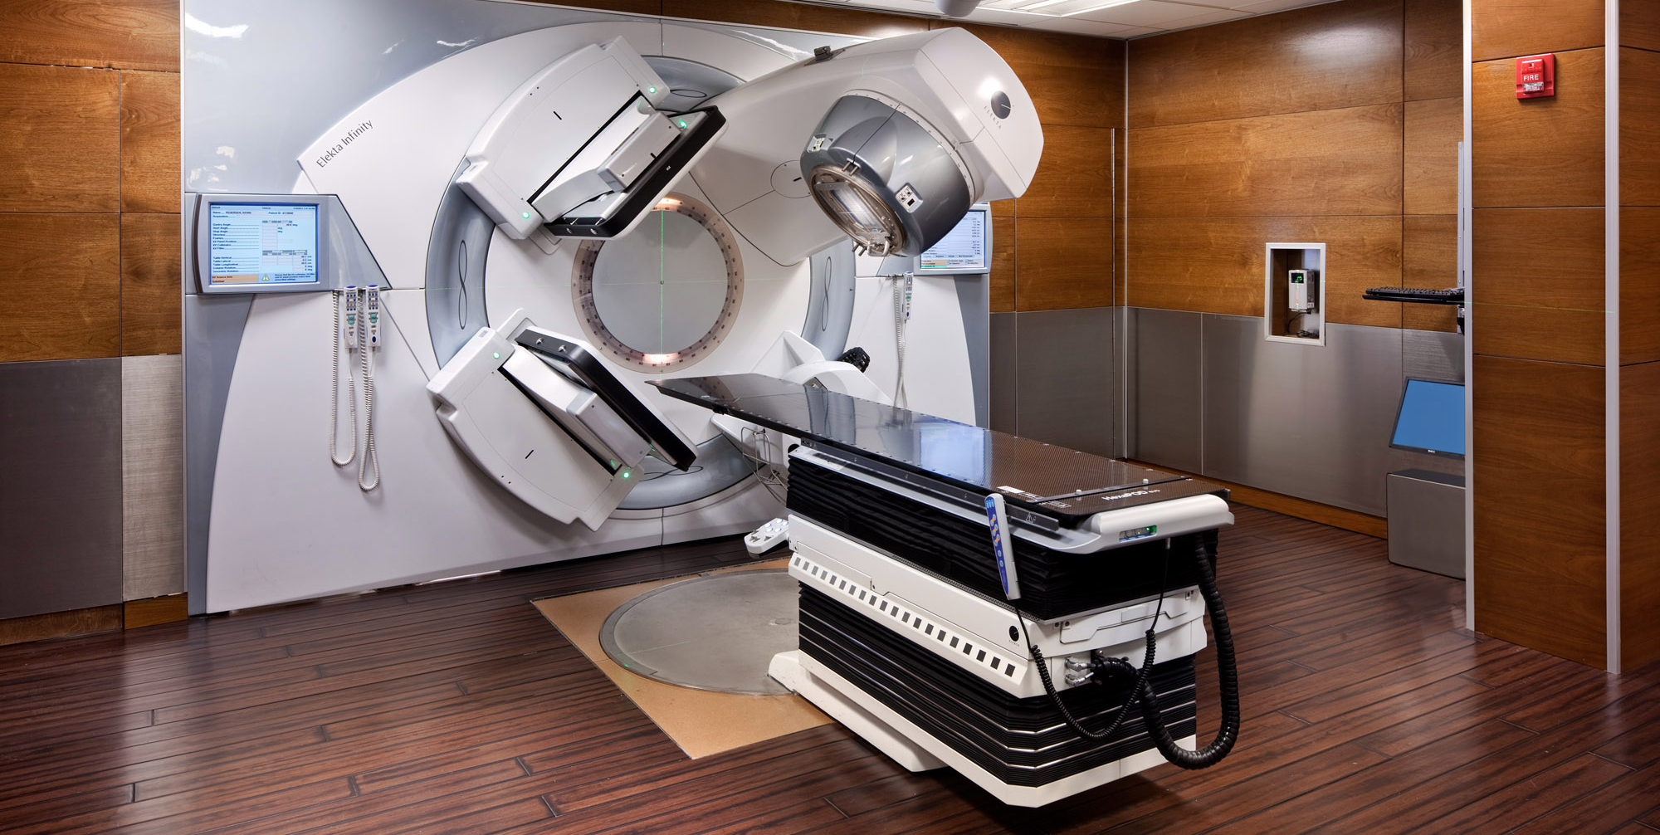

Slide 6
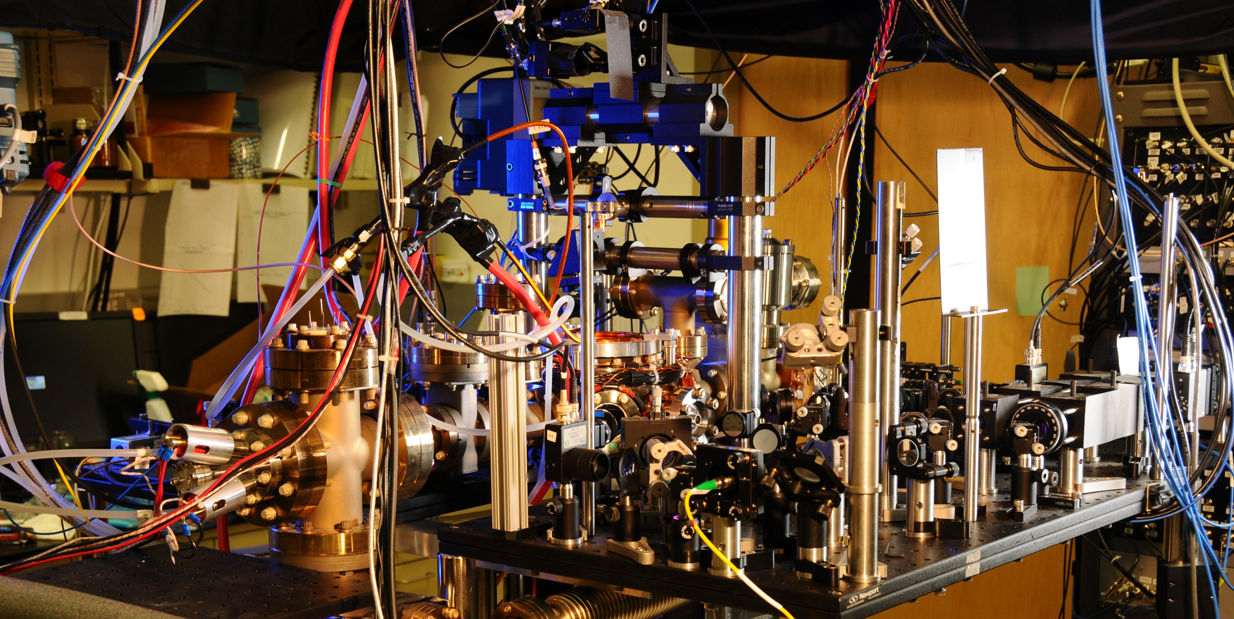
Notes:
Spanner ( Google’s modern relational database management systems that seek to provide the same scalable performance of NoSQL systems for online transaction processing (OLTP) read-write workloads while still maintaining the ACID guarantees of a traditional database system.^{[)1][2][3])}

Slide 7
You still have problems

Slide 8


Slide 9


Slide 10


Slide 11
You don’t have technology problems
Solving technology problems isn’t your business

Slide 12





20 - 40%
40 - 60%
60 - 80%
Notes:
PHILLIP:
What percentage of your IT organization’s time is spent on solving business problems?

Slide 13
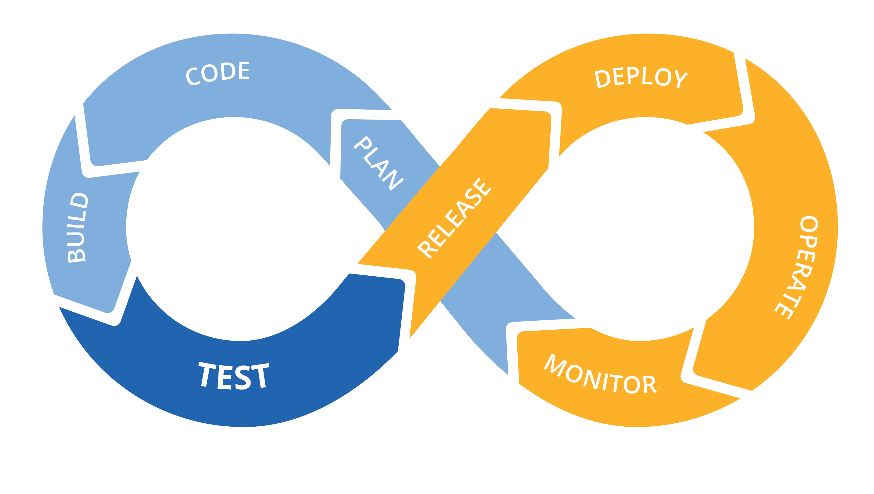
We have nothing new to offer
Notes:
PHILLIP:
Infrastructure automation paired with teams that support what they build isn’t new. This is DevOps, started to gain traction X years ago.
Infrastructure as code
CI/CD for increased speed and stability
Monoliths to microservices to functions
Small teams, highly cohesive and loosely coupled
Only pay for what you use
Polyglot – the right language/framework for the job

Slide 14
Energy
 | Time
Notes:
PHILLIP
What is new is this. Any associations? Drawing a blank? Can you smell the bunson burners from high school chemistry class?

Slide 15



Energy
 | Time
Activation energy
Notes:
This is a graph showing a chemical reaction.

Slide 16
Technology problems
 | Time
Difficulty of the change
Time required for change

Slide 17
Technology problems
 | Time
Catalysts change the equation

Slide 18
Technology problems
 | Time
Serverless
is the catalyst
Catalysts change the equation

Slide 19


f(n) + +
Notes:
JACK
Yes, there are still servers.
And ‘serverless’ is such a popular term that it’s taking on a life of its own.
What we are talking about when we talk serverless:
Short lived functions measured in seconds or fractions of second)
epheremal biz logic
Managed services
just like orgs used to have a CEO (chief electricity offer) so are managed services
Tools/frameworks to support development

Slide 20


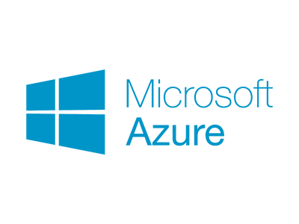


f(n) + +
Notes:
JACK
Compelling offerings in the space, and what we have experience with
So those are technologies. But our hypothesis is about serverless market offerings. It’s actually a bit broader. To take us our hypothesis.
PASS
PHILLIP – We’re pumped about this.

Slide 21

Notes:
Reduces friction, helps you do the right thing

Slide 22

Small, product focused teams
Notes:
Natural fit between small, short-lived function and small product focused teams.
Coincidentally, small teams with a 'you built it, you support it' mentality is the bedrock of DevOps.
Adoption is not the same as adopting a new dev toolkit. It’s organizational.
If you have a DevOps department, you might be doing it wrong.

Slide 23

Notes:
No more death star projects

Slide 24

Faster Time-to-Market
Notes:
Time to market
Levels the playing field
Let's us all be cheetah's

Slide 25


Notes:
Accelerated IT ecosystem diversity.
BUILT IN AUTOMATION
You’ve heard ‘we’re a .NET shop, or we’ve standardized everything on Java’
This makes sense – it allows for uniform support when your highly paid designers and devs go on the next project, passing support off to a different set of people with different capabilities.
Standardization also makes ensuring your overall enterprise architecture doesn’t fly off the rails.
In a serverless world, security contracts should be in code, transparent, and enforced at deploy time.
IT Governance will get more effective while cost becomes constant.
The decoupling of governance costs from app dev removes the primary motivation for standardization. Don’t be surprised if a couple years from now, your running a Java function right next to a Haskall function.

Slide 26


Data driven decision making
Notes:
PHILLIP

Slide 27

Notes:
PHILLIP:
If relying on large efforts to change the organization and add business value, putting all your eggs in a single basket
Implies being able to clearly see the end from the beginning
Huge opportunity cost
Feel your way along and change to what’s working better

Slide 28

Notes:
When your people have been freed to focus on problems, maybe instead of running the experiments themselves like our hero in the Unilever story, they’ll write systems that run the experiments for them.
In the future, when
serverless is the norm,
usage data is granular, abundant, and accessible, and
machine learning moves further into the commodity space
The heroic experimentor will be the machine. The idea of software products and services assembling themselves based on ML models isn’t quite as crazy as it sounds.

Slide 29
Energy
 | Time
Notes:
JACK

Slide 30

Technology problems
 | Time

Slide 31


Technology problems
 | Time
Notes:
Serverless is a unique opportunity to free your people’s brains to solve business problems instead of IT problems
- unlock revenue
- grow business
- drive innovatation

Slide 32
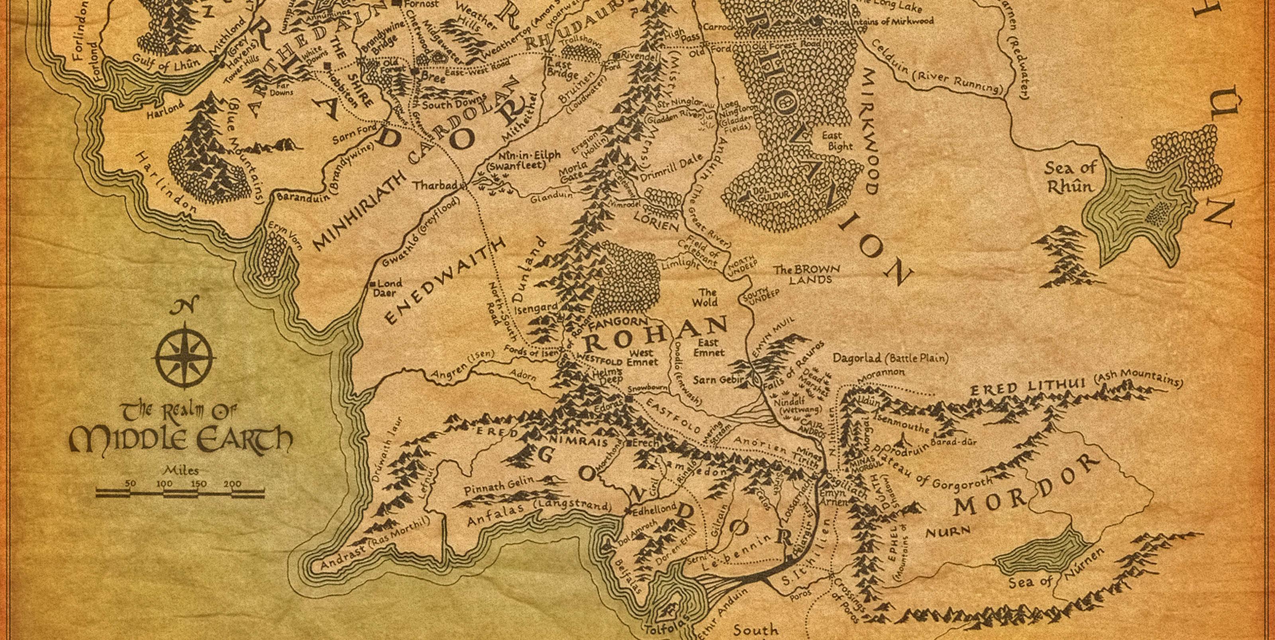



Notes:
If the people you’ve hired have built a mature DevOps and cloud company they already know about serverless and love it, and probably are already using it
If the people you’ve hired haven’t built a mature DevOps and cloud company
If they would like to but can’t for whatever reasons, they likely know about serverless and have used it on side projects and love it
If they aren’t pushing for DevOps or cloud there’s a good chance they don’t know anything about serverless (or DevOps practices in general)
Know the group you are working with

Slide 33








